Slide 1
Tax Foundation University
Session 2: The Business Tax Code

Slide 2
Areas of Focus
The Basics of Corporate Income Taxes
The Basics of Noncorporate Income Taxes
The Impact of Business Taxes on Investment and Workers
Do Corporations Pay “Zero” in Federal Taxes?
TCJA Expirations and Options for Reform

Slide 3
Principles of Sound Tax Policy
Simplicity
Neutrality
Transparency
Stability
Tax codes should be easy for taxpayers to comply with and for governments to administer and enforce.
Taxes should neither encourage nor discourage personal or business decisions. The purpose of taxes is to raise needed revenue, not to favor or punish specific industries, activities, and products.
Tax policies should clearly and plainly define what taxpayers must pay and when they must pay it. Hiding tax burdens in complex structures should be avoided.
Taxpayers deserve consistency and predictability in the tax code. Governments should avoid enacting temporary tax laws, including tax holidays, amnesties, and retroactive changes, and strive to establish stable revenue sources.

Slide 4
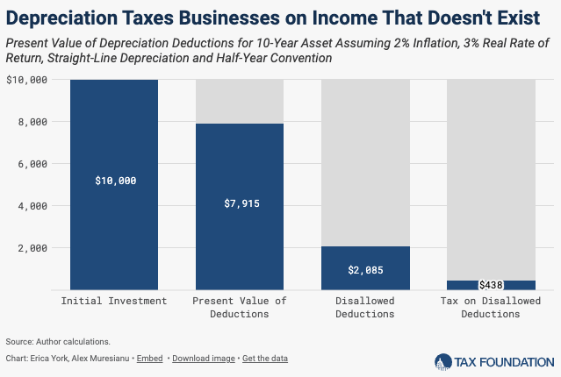
The Business Tax Base
Profits = revenues less expenses incurred from earning revenues, except for capital investments
Deductions include
Net operating losses (NOLs) smooth profits over time
Interest payments (with limits)
State and local taxes paid
Notes:
Capital investments must be depreciated over time
Depreciation artificially increases taxable income and the cost of capital
Depreciation is counted as a “tax expenditure” but is a normal part of a tax code that is neutral toward investment
A Net Operating Loss (NOL) Carryforward allows businesses suffering losses in one year to deduct them from future years’ profits. Businesses thus are taxed on average profitability, making the tax code more neutral. In the U.S., a net operating loss can be carried forward indefinitely but are limited to 80 percent of taxable income.
Imagine a business has $50 in losses in one year and then $100 in profits in the subsequent year. Without a carryforward provision, the business would not be taxed in the first year but would be taxed on the full $100 in profits in the second year.
A carryforward provision would allow the business to “carry forward” its $50 loss in year one to reduce its taxable profits in year two, averaging the taxable profits over the two years.
Prior to the enactment of TCJA, businesses were generally allowed to deduct their total amount of interest paid, subject to a few minor limitations. One of the central provisions in TCJA was the creation of a limit on the deduction for business interest paid, intended to reduce the tax code’s preference for debt over equity.[6] Starting in 2018, companies generally are no longer allowed to deduct net interest more than 30 percent of their “adjusted taxable income.” Until the end of 2021, “adjusted taxable income” was defined in a manner similar to the EBITDA income concept: a broad measure of a business’s income, which doesn’t take into account how much investment-related deductions a business claims.[8] This means that the threshold for hitting the limitation on interest deductibility will be relatively high (30 percent of a broad income concept), and that businesses that invest more won’t be in greater danger of hitting the threshold. But after 2021, the limit on the deduction for net business interest became significantly tighter. This is because the definition of “adjusted taxable income” is scheduled to switch to one similar to the EBIT income concept: a narrower measure of a business’s income, which subtracts out businesses’ investment-related deductions.[9] As a result, after 2021, the threshold for hitting the limitation on interest deductibility is lower (30 percent of a narrow income concept), and the interest limitation is more binding.

Slide 5
The Corporate Rate
Then: 38.9% combined average
Now: 25.8% combined average
Tax Rate x Tax Base = Tax Liability
Tax credits can offset liability
R&D tax credit
Green energy tax credits
Semiconductor investment tax credit
LIHTC

Slide 6
Shareholder Level Taxes
Entity level tax on profits
Plus: shareholder level tax on profit distributions
Dividends
Capital gains realizations
Results in two layers of tax on corporate income

Slide 7
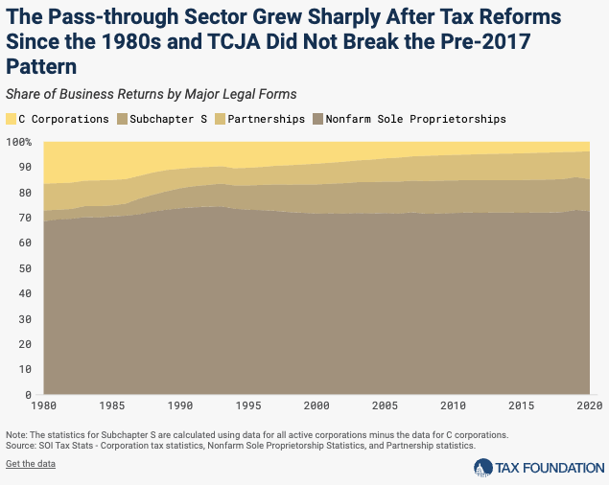
Noncorporate Income Taxes
Pass-through entities pass profits (or losses) directly to individual owners, single layer of tax
Taxed at personal tax rates
Owners take deductions, like Sec. 199A and Sec. 179
Vast majority of US companies are pass-throughs
Notes:
Business income in the United States is taxed under two different systems. C corporation income is taxed first at the entity level by the 21 percent corporate income tax and then again at the shareholder level by the individual income tax when profits are distributed (e.g., the top long-term capital gains tax rate is 23.8 percent). Pass-through businesses—including partnerships, sole proprietorships, and corporations electing to be taxed at the shareholder level (e.g., Subchapter S corporations, regulated investment companies [RICs], and real estate investment trusts [REITs]) do not face the corporate tax. Their business income is passed through to their owners and taxed on their individual income tax returns at rates of up to 37 percent.
Since the early 1980s, the pass-through sector has grown substantially as a share of all business activity. The pass-through share of business returns increased from 83.4 percent in 1980 to 96.2 percent in 2016 (see the first figure below). The number of C corporations decreased from around 2.2 million in 1980 to 1.6 million in 2016. During the same period, the total number of business entities tripled to 39 million. Pass-through businesses accounted for two-thirds of all net income (less deficit) in 2016, substantially increasing from 25.4 percent in 1980. The sharp growth in the pass-through sector since the 1980s was due in part to a significant improvement in their relative tax treatment. Tax reforms in 1981 and 1986 cut the top individual income tax rate from 70 percent in 1980 to 28 percent in 1988, while the top corporate income tax rate came down from 46 percent to 34 percent.
For pass-through businesses, the TCJA reduced statutory individual income tax rates and enacted the Section 199A pass-through deduction. This deduction enables pass-through owners to deduct up to 20 percent of their qualifying business income against their taxable income. The pass-through deduction includes several limitations based on wages paid and capital for high-income taxpayers. The deduction lowers the effective statutory tax rate on pass-through business income.
Section 199A was created to ensure what supporters call “parity” between pass-through businesses and corporations. However, recent estimates suggest the deduction essentially maintains and extends the pre-TCJA tax preference for pass-through income.
The most recent data from the IRS suggests that the trend toward more pass-through businesses and fewer C corporations has not broken.

Slide 8
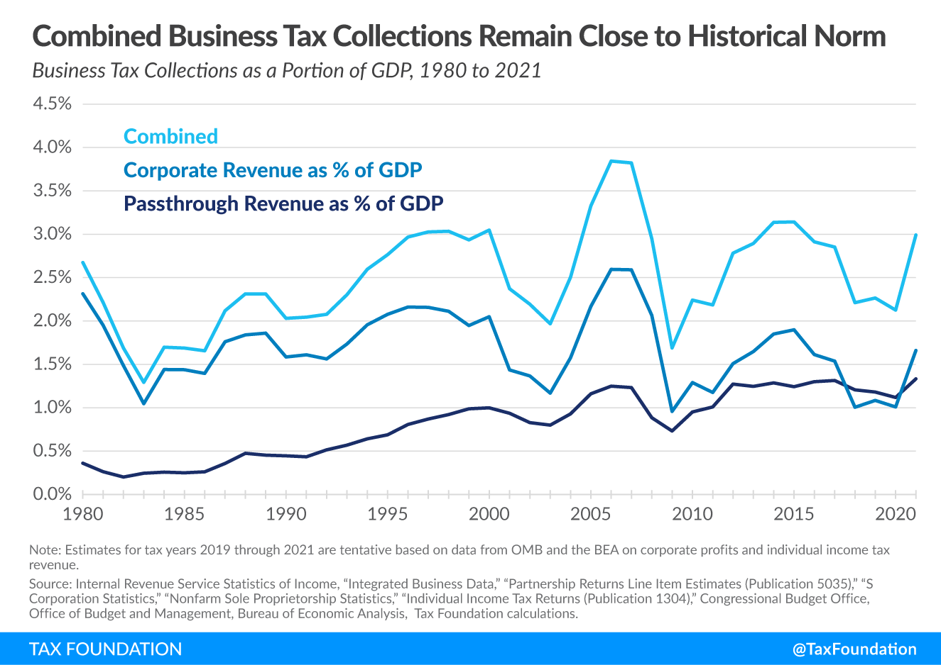
Business Tax Revenue
Fewer corporations = lower corporate revenue as % of GDP
FY2024 corporate tax revenues totaled $530 billion out of $4.9 trillion in total taxes
Corporate + noncorporate revenues = total business revenues—US near historical norms

Slide 9
Impact of Corporate Taxes on Investment
 | METR | AETR
United States, maintain TCJA biz policies | 11.2% | 21.5%
United States, current law | 18.3% | 23.4%
OECD average | 15.5% | 22.9%
Note: Estimates do not account for R&D tax credits. Source: Kyle Pomerleau, “The tax burden on corporations: A comparison of Organisation for Economic Co-operation and Development countries and proposals to reform the US tax system,” American Enterprise Institute, Oct. 13, 2021, https://www.aei.org/research-products/report/the-tax-burden-on-corporations-a-comparison-of-organisation-for-economic-co-operation-and-development-countries-and-proposals-to-reform-the-us-tax-system/.
Statutory tax rates affect location of profits
Marginal effective tax rates affect investment level within a jurisdiction
Average effective tax rates affect location of investment
Notes:
The corporate income tax affects investment incentives by raising the cost of capital, making it more costly for companies to invest in equipment, factories, and productive technologies. The tax burden on corporate investment consists of the statutory tax rate and structural elements of the corporate tax code such as deductions and credits. The burden of the corporate tax can be evaluated through different measures, particularly the statutory tax rate, the marginal effective tax rate, and the average effective tax rate.
Statutory tax rates affect the location of profits; at the margin, a higher statutory tax rate encourages profit shifting to jurisdictions with lower statutory tax rates.
The statutory tax rate, however, does not fully reflect the burden of the corporate tax, because structural components such as depreciation deductions also affect the cost of making investments. Measures of effective tax rates capture many other important elements of the corporate tax system and illustrate how the corporate income tax affects incentives about how much to invest or where to locate investment.
The marginal effective tax rate (METR) measures the tax rate a hypothetical new, break-even investment would face, taking into account the statutory tax rate and other structural elements of the tax system such as depreciation deductions, limitations on interest deductions, and special rates. The METR is used as an indicator of marginal investment incentives within a jurisdiction; a METR of zero indicates no tax on marginal investments.
The average effective tax rate (AETR) is similar but measures the tax rate for an investment that earns an above-normal return, or does better than breaking even. The AETR is used as an indicator of asset-location incentives; corporations have an incentive to shift high-return assets away from jurisdictions with relatively high AETRs.
If the United States maintained 100 percent bonus depreciation, immediate expensing of R&D, and other policies in place in 2021, its METR would be 11.2 percent. Because of scheduled policy changes in the U.S., however, tax treatment of domestic investment will worsen in the next several years.
Accordingly, using a current law baseline to reflect the upcoming changes shows the METR in the United States will reach 18.3 percent after all scheduled changes take place.

Slide 10
Impact of Corporate Taxes on Workers
Legal Incidence
Economic Incidence
Modeling
Harm of Corporate Tax
Corporations pay the taxes!
But who bears the burden?
JCT: 75% capital, 25% labor
Tax Foundation: 50% capital, 50% labor
Economic Literature: 70% up to 100% can fall on labor
Fuest et al: corporate taxes reduce wages more for young workers, the low-skilled, women
Economists, including at the OECD: corporate income tax most harmful and least efficient way to fund priorities

Slide 11
Do Corporations Pay $0 in Federal Taxes?
Book Income
Taxable Income
Not Loopholes, Laws
Take the Long View
Determined by accounting standards, rules and guidelines set by the Financial Accounting Standards Board (FASB)
Designed to give shareholders a consistent picture of financial performance
Rules designed by Congress to raise revenue and encourage or penalize certain business activities
Taw laws enacted by Congress , like credits, deductions, tax losses, differ from accounting rules
A one-year snapshot is inaccurate, over longer horizon the timing differences between tax laws and accounting rules largely disappear
Notes:
Book income is defined using Generally Accepted Accounting Principles (GAAP) and is designed to report profits consistently in a way that reflects a business’ financial performance. GAAP requires accrual accounting, which has implications for measuring both costs and earnings.
if a construction firm purchases several new vehicles, the full cost of that purchase would not be reflected in a calculation of book income in the purchase year. Instead, the cost would be accounted for as the value of those vehicles depreciates. Even though the business expense (and the cash out the door) occurred in a single year, the business would account for that expense over multiple years.
Book income treats earnings in a similar way. If a client makes a purchase for a future delivery, but only pays the bill after the delivery is completed, the company making the sale will need to book the earnings even if the cash is not in the door (as an accounts receivable).
Combining both the accrued costs and earnings into book income allows for an overall financial picture of a firm that may not perfectly match economic reality. This mismatch could be something as simple as cash that has been spent for a purchase but only part of the cost is reflected in financial accounts because of depreciation.
Financial statements include taxes paid by firms. These tax numbers are sometimes used to measure tax as a share of book income. But because book income is calculated differently than taxable income, it is common for those income measures to diverge. Because of this, an effective tax rate calculated as taxes paid (as reported on financial statements) divided by book income may not match the effective tax rate if measured by dividing taxes paid by taxable income.
Major differences occur because of provisions like NOLs and capital investment. Combining these provisions can mean that a firm can appear to be profitable on its financial statements, but also mean that it pays little or no federal income tax.
The new 15 percent minimum tax on book income (also known as the corporate alternative minimum tax, or CAMT) is not as simple as it may sound. The 15 percent minimum tax applies to corporate book income, with certain adjustments, for corporations with profits over $1 billion, effective for tax years beginning after December 31, 2022.
Adjustments include using tax depreciation instead of book depreciation, allowing tax credits, adjustments for ambiguities between book and tax rules, etc.
As a new tax on a new tax base (adjusted financial statement income), it introduces a variety of problems and unintended consequences, embroiling taxpayers and administrators in several knotty issues that remain unresolved. Implementation has been challenging and initial regulatory guidance released by the Treasury Department and IRS addressed only a limited set of issues, leaving more questions than answers for taxpayers and practitioners as detailed in hundreds of pages of comment letters
Some of the outstanding issues with the BMT are so daunting it is currently unclear the tax can be salvaged as a viable revenue raiser without greatly increasing compliance costs and taxpayer uncertainty.
To the extent the BMT is implemented, there is no reason to think it would ensure a minimum level of taxation since it allows tax credits and other tax preferences. Instead, whatever revenue it raises would arbitrarily penalize certain companies, such as those with past losses and foreign earnings.[94] Accountants have warned the BMT could reduce the quality of financial information. As these and other problems become more apparent, the case for repealing the BMT will grow. Congress should cut to the chase and relieve taxpayers and the IRS from the burden of the BMT.

Slide 12
TCJA Expirations and Options for Reform
The Expirations
Other Potential Proposals
R&D expensing
Bonus depreciation
Net interest limitation
Pass-through provisions
International provisions (tomorrow)
Lower corporate tax rate
Lower corporate tax rate for specific industries
Accelerated deductions for structures investment
Limitations on deductions for C-SALT
Eliminate green energy tax credits

Slide 13
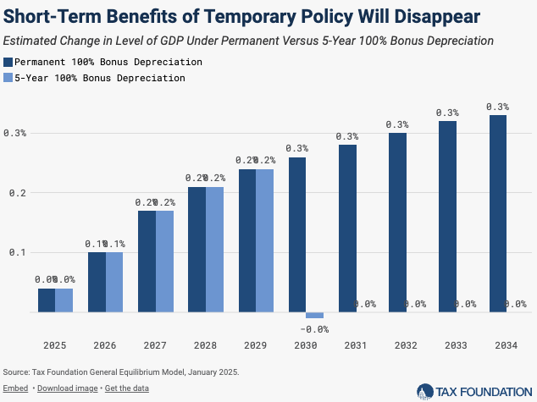
TCJA Expirations and Options for Reform
Fundamental reform vs current framework
In both cases:
Economic growth requires permanence

Slide 14
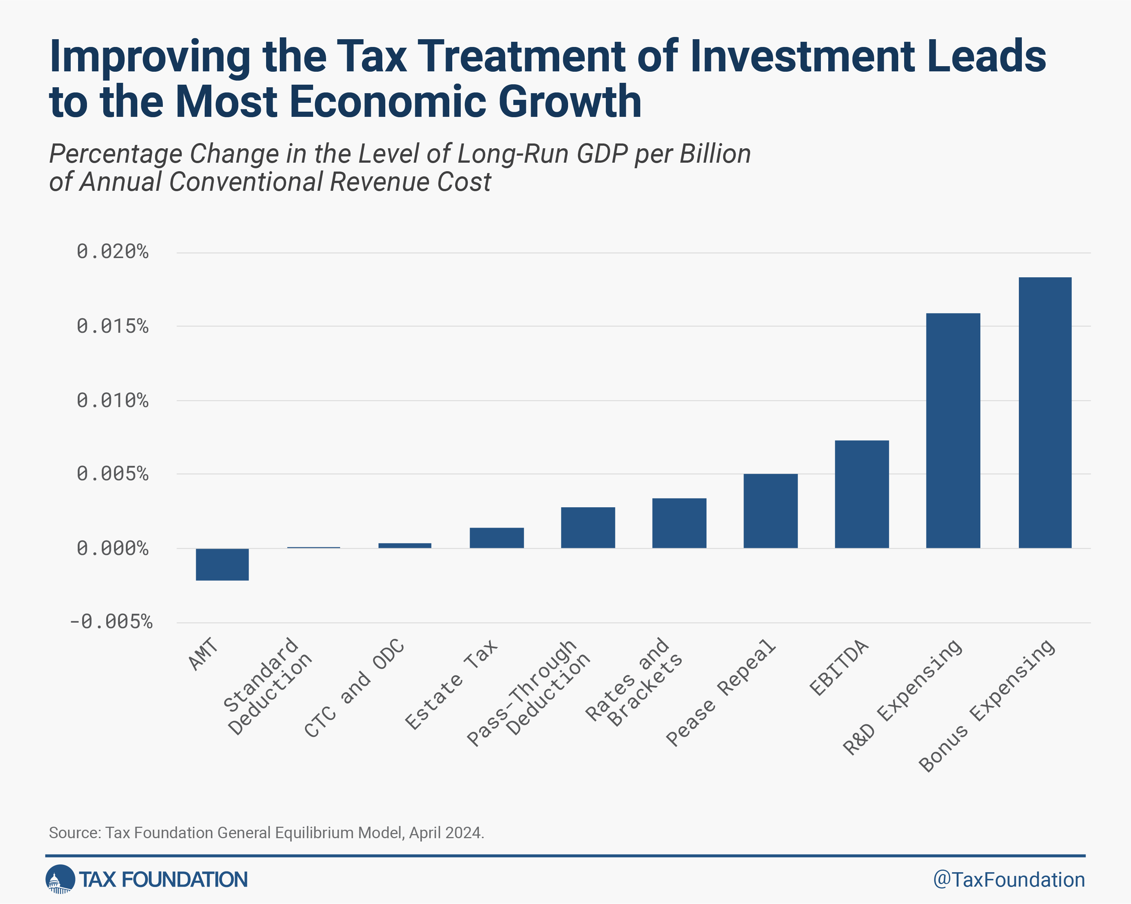
TCJA Expirations and Options for Reform
Prioritize reforms that offer
Most bang for the buck
Greatest simplification
More neutrality
Notes:
Even though the share of business entities filing as pass-throughs continued increasing after the TCJA, C corporations and pass-through businesses kept their relative weights in terms of profits and business receipts. A few factors can help explain the trend. The data through 2020 only present a short-term effect, and a few more years of data would provide a more complete picture. Further, Section 199A is a temporary provision and hard to navigate, so utilization of the provision could change somewhat over time. As well, businesses face all kinds of transitional costs in switching business forms, and the adjustment process could take several years to unfold. However, the continuing decline in both the number of C corporation returns and the C corporation share of business returns suggests that TCJA did not result in a massive conversion to the C corporation form (as predicted by other researchers at the time) and largely preserved the general tax advantage of the pass-through form.
Ideally, the choice of business form should not be influenced by tax considerations. The current tax treatment of businesses is far from ideal, as it applies two very different tax systems that are very difficult, if not impossible, to bring into parity. As lawmakers debate what to do about the expirations of the 2017 tax law, they should consider more fundamental reforms to integrate business taxation, such as moving to a distributed profits tax. Short of a fundamental reform, moving the tax code in the direction of simplicity, neutrality, and certainty should be the goal.

Slide 15
Wrapping Up
Rate The 21% corporate tax rate brings the US in line with the worldwide average
Base Any policy short of full expensing discourages capital investment
Burden The burden of the corporate tax falls on workers and shareholders
Tax versus Book Taxable income differs from book income for good reasons
Big Issues Broad investment provisions are expiring thus raising the cost of capital, pro-growth impact requires permanence

Slide 16
Questions?
Erica York
eyork@taxfoundation.org
@ericadyork

